Slide 1
Comparing ‘rice blasts’
From:
Dong et al. 2015
Chen et al. 2013

Slide 2
Some background info …

Slide 3
From Dong et al. 2015 (98-06 vs. 70-15)

Slide 4
From Dong et al. 2015 (98-06 vs. 70-15)

Slide 5
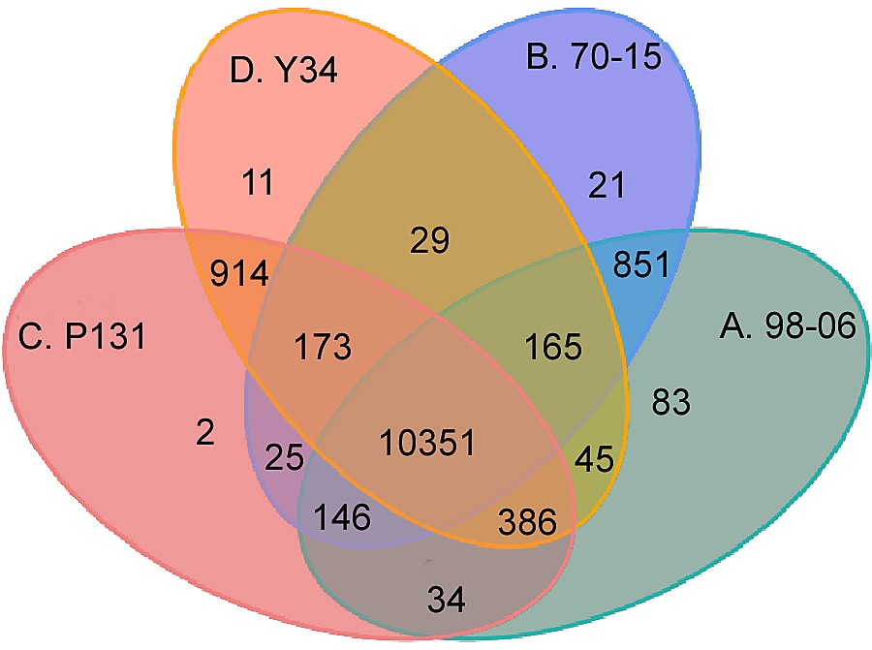
From Dong et al. 2015 (Protein clusters Venn)

Slide 6
From Chen et al. 2013 (three strain comparison)

Slide 7
From Chen et al. 2013 (three strain comparison)

Slide 8
One more thing ….
Study accession | Sample accession | Secondary sample accession | Experiment accession | Run accession | Tax ID | Scientific name | Instrument model | Library layout | FASTQ files (FTP)
PRJNA259589 | SAMN03010511 | SRS692257 | SRX689727 | SRR1561422 | 318829 | Magnaporthe oryzae | AB SOLiD 4 System | PAIRED | File 1 File 2

